Slide 1
Hands-on Robot Operating System (ROS)
programming robots and language technology
November 2020
Mehdi Ghanimifard

Slide 2
Outline
Intelligent Agent Schema
Robot Operating System
What
Why
How
< A short break! >
The programming tutorial (live code)
Some examples
+ Kinect (What/How)
+ Keras in ROS

Slide 3
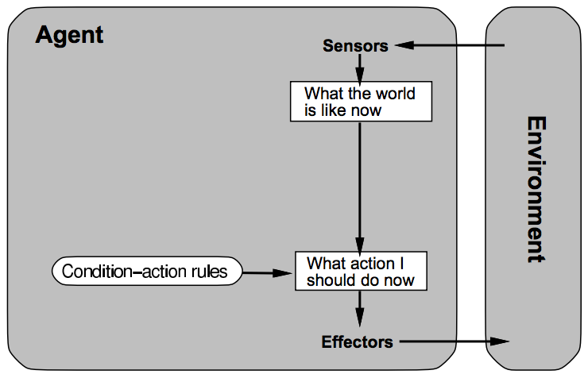
Intelligent Agent Schema
A simple reflex agent
Source:
Artificial Intelligence: A Modern Approach (1995)
by Stuart Russell and Peter Norvig. Prentice-Hall, Inc.

Slide 4
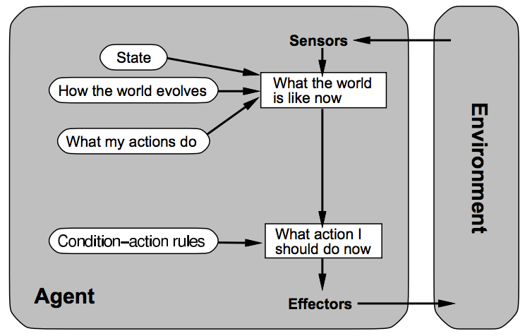
Intelligent Agent Schema
A reflex agent with internal state
Source:
Artificial Intelligence: A Modern Approach (1995)
by Stuart Russell and Peter Norvig. Prentice-Hall, Inc.

Slide 5
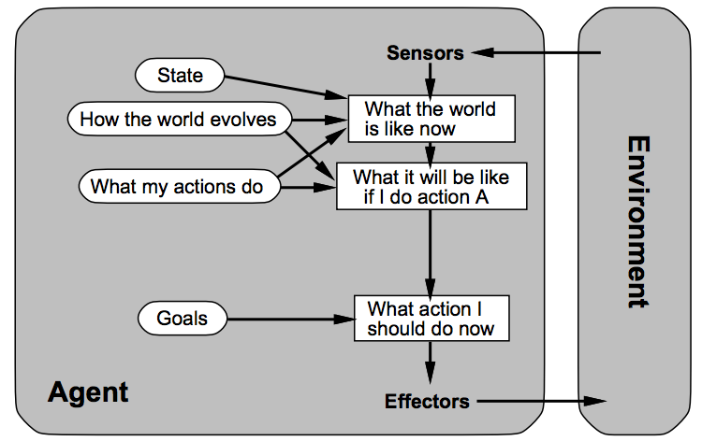
Intelligent Agent Schema
An agent with explicit goals
Source:
Artificial Intelligence: A Modern Approach (1995)
by Stuart Russell and Peter Norvig. Prentice-Hall, Inc.

Slide 6
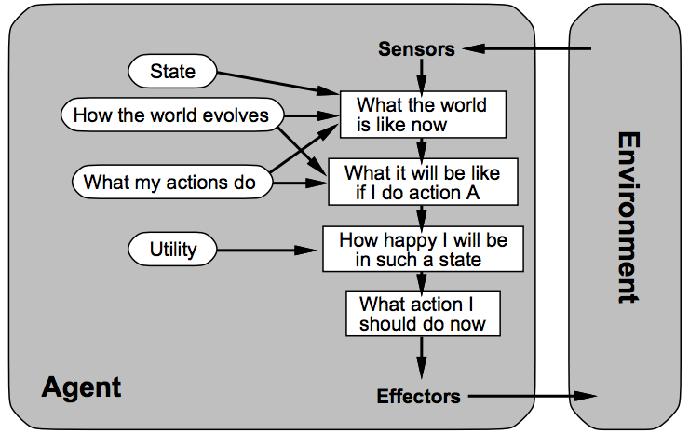
Intelligent Agent Schema
A complete utility-based agent
Source:
Artificial Intelligence: A Modern Approach (1995)
by Stuart Russell and Peter Norvig. Prentice-Hall, Inc.

Slide 7
Generalization over Agent Schema
Environment
Sensors
Perception
Program
Actuators
Action
Agent

Slide 8
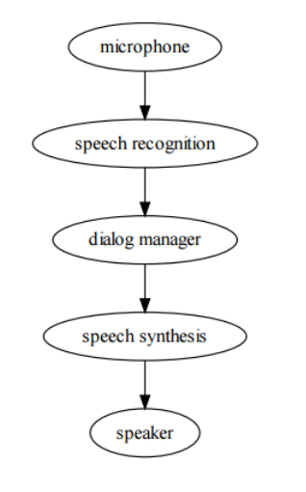
Maybe this program?

Slide 9
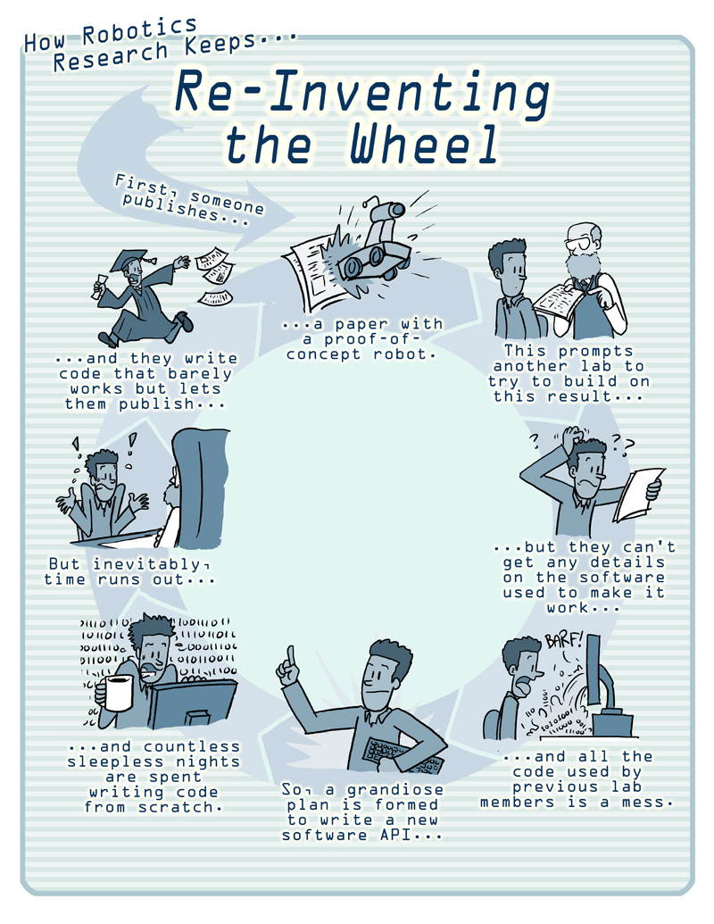

Slide 10
What is ROS?
ROS = Robot Operating System
ROS is a platform for robot software.
Goal: advance open-source robotics
Meta-operating system = It’s built on top of the OS (Linux, Mac, Windows, …)

Slide 11
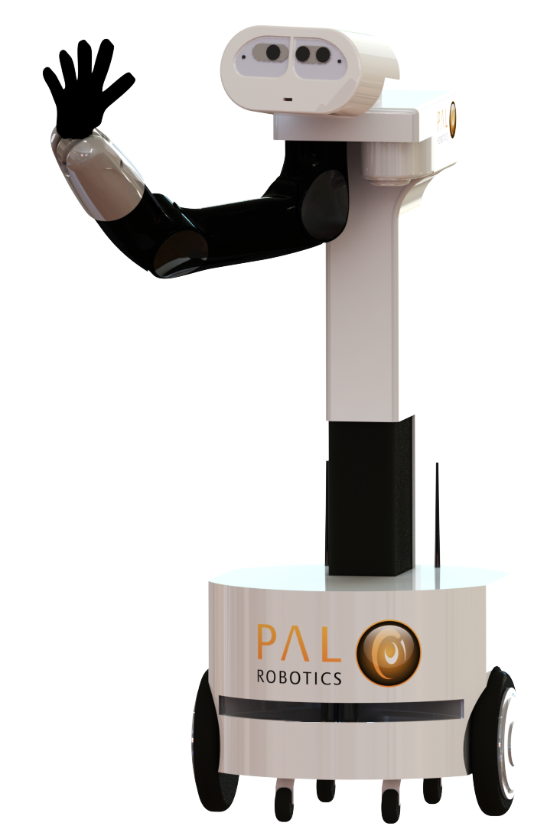
How fast can you start robot programing?
You need a computer (preferably Ubuntu)
Programming knowledge: Python
Robot simulation / any robot compatible with ROS: http://wiki.ros.org/Robots
Robotics by nature is multi-disciplinary: Some knowledge from other fields is required.
Use open-source projects if it is easy.

Slide 12
Why ROS?
Solving these three issues:
Complexity of a big software.
Abstraction for specific robot hardware.
Sequential programming on asynchronous environment.

Slide 13
1. Complexity in big software
➜ ROS: Separating processes
How to organize a big software with several different pieces:
Sensors: camera, laser, infrared, ultrasonic. Motors: step, dc
Image processing, Audio processing, etc.
Dialogue system, Planning, SLAM, etc.
Organize all tasks as a network of separated processes
Each process runs separately over the network
Each process can communicate with others

Slide 14
2. Abstraction for specific robot hardware
➜ ROS: Message interfaces
Programming for a robot software without making abstraction over hardware leads to hardware-dependent software.
A hardware abstraction has a standard message interface.
e.g. a camera driver or generally an image sensor, publish messages in type of sensor_msgs/Image and publish it on /camera/rgb/image_color By changing camera hardware the other parts of the software stays intact.

Slide 15
3. Sequential Programming.
robot = Robot()
do {
image = robot.get_image_from_camera() belief = robot.update_belief(image)
path = robot.find_the_path(belief)
goal = robot.go_to_the_goal(path)
} while (goal)
An obstacle stops go_to_the_goal. now what?
How could camera use online image to avoid collision?

Slide 16
➜ ROS: asynchronous events with Callbacks
def image_callback(image):
# … do something with image -> belief
pub.publish(belief)
if __name__ == '__main__':
# …
pub = rospy.Publisher("/mybot/belief", String, latch=True)
rospy.Subscriber("/camera/rgb/image_color", Image, image_callback) rospy.spin()

Slide 17
➜ ROS: asynchronous events with Callbacks
def belief_callback(belief):
# … do something with belief -> path -> commands
pub.publish(commands)
if __name__ == '__main__':
# …
pub = rospy.Publisher("/motor/control", Twist, latch=True)
rospy.Subscriber("/mybot/belief", String, belief_callback) rospy.spin()

Slide 18
Design of ROS
Peer-to-peer: several processes, doesn’t rely on central server.
Tools-based: microkernel design + several small tools.
Multiple languages: C++, python, LISP, …
Thin: re-uses code from other projects, drivers, navigation system, simulators, vision algorithms, and etc.
Free and Open-Source: Open source core but the licence allows to produce modules with different licence.
Source:
Quigley, Morgan, et al. "ROS: an open-source Robot Operating System." ICRA workshop on open source software. Vol. 3. No. 3.2. 2009.

Slide 19
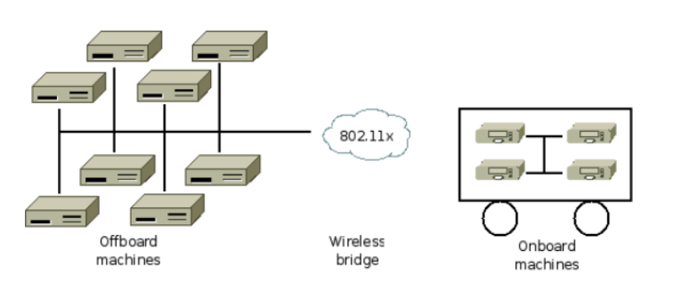
Design of ROS
Source:
Quigley, Morgan, et al. "ROS: an open-source Robot Operating System." ICRA workshop on open source software. Vol. 3. No. 3.2. 2009.

Slide 20
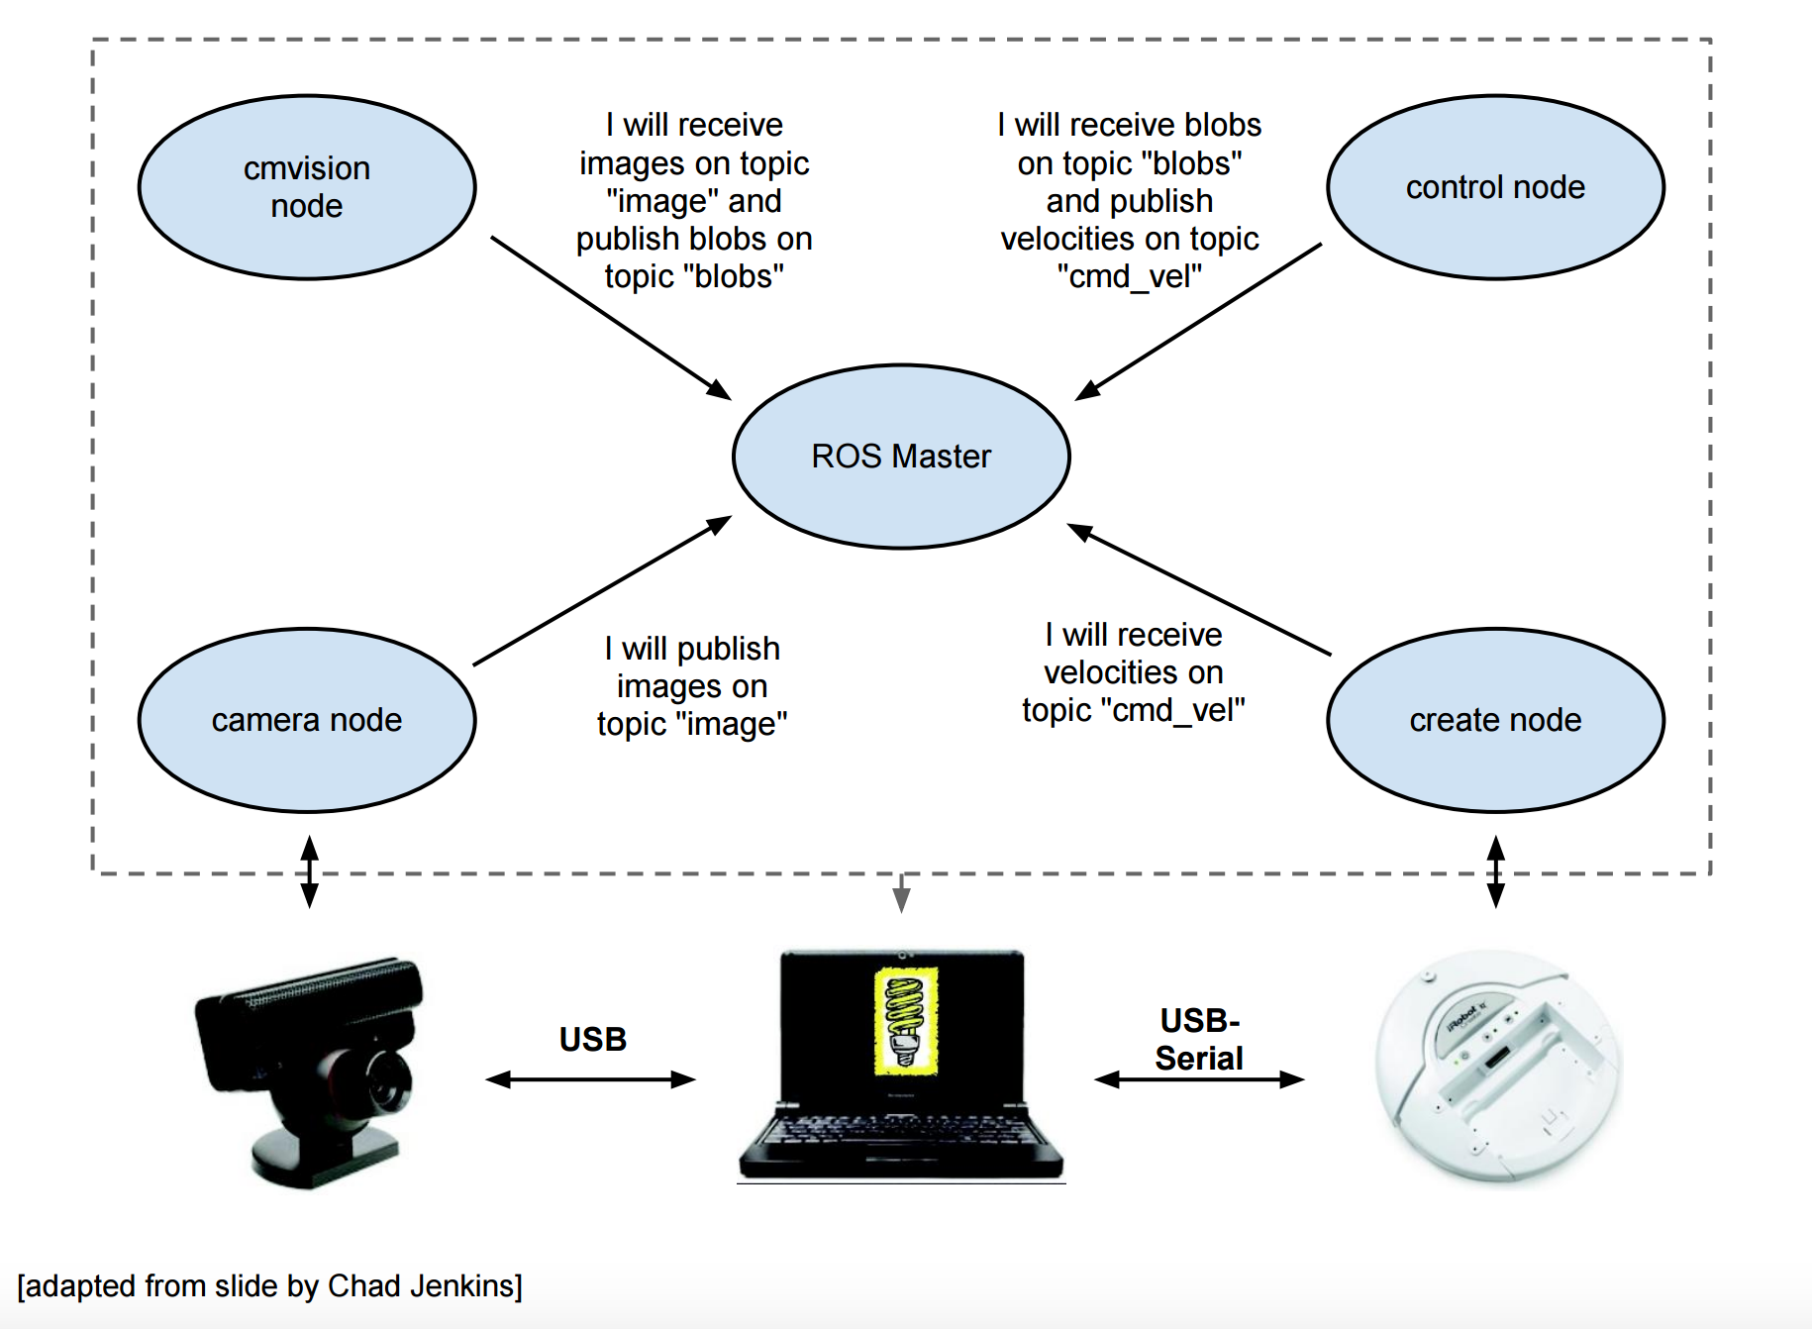
How ROS works
From slide by Todd Hester (University of Texas - CS378)

Slide 21
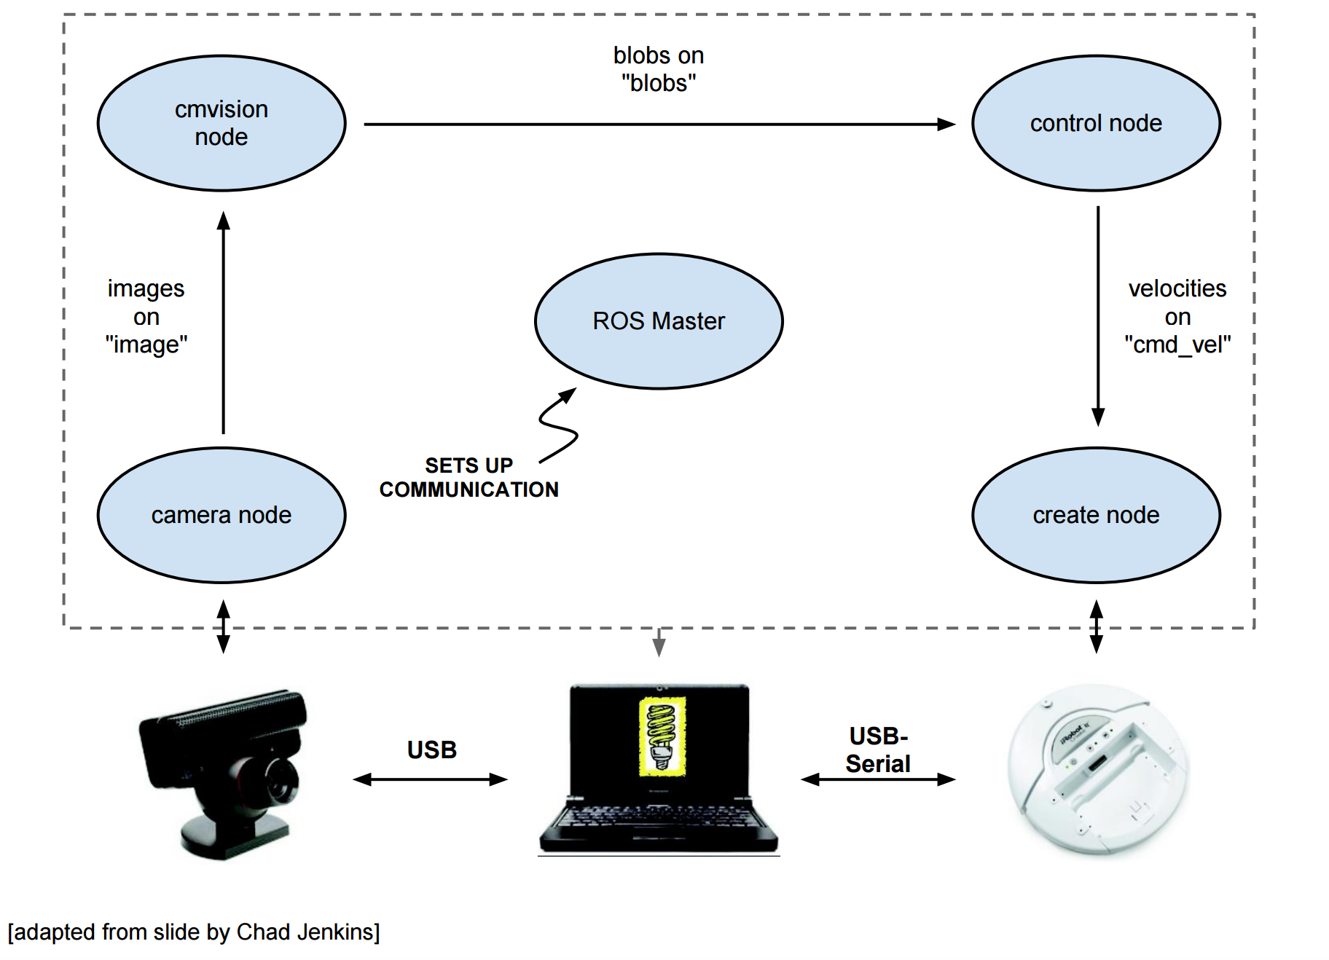
How ROS works
From slide by Todd Hester (University of Texas - CS378)

Slide 22
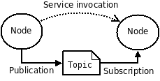
Architecture of ROS robots
ROS is organized as a network of nodes (processes).
ROS master (roscore) stores all network data (addresses).
Nodes on startup register themselves with master.
Each node performs a single task.
Nodes coordinate with each other through topics or services.
Nodes can subscribe or publish to a topic with a specific message type.
topics are suitable for asynchronous transactions with broadcast
services are suitable for synchronous transactions

Slide 23
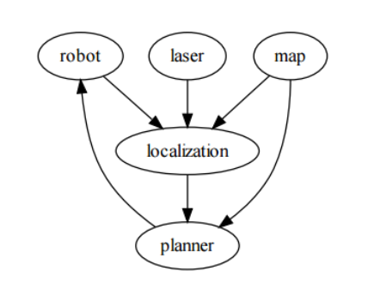
Examples: network architecture of nodes
communication pipeline
navigation system

Slide 24
Nodes, Topics, Publish/Subscribe, Message
Node 1:
commander = rospy.Publisher("/myrobot/commands", String)
r = rospy.Rate(10) # 10hz
while not rospy.is_shutdown(): commander.publish("go forward") r.sleep()
Node 2:
def cmd_callback(cmd_string):
# do something
if __name__ == '__main__': rospy.Subscriber("/myrobot/commands", String, cmd_callback) rospy.spin()

Slide 25
Live Coding!

Slide 26
Processing RGB-D/Kinect images
Malinowski, M., & Fritz, M. (2014). A multi-world approach to question answering about real-world scenes based on uncertain input. In Advances in Neural Information Processing Systems (pp. 1682-1690).
https://www.mpi-inf.mpg.de/departments/computer-vision-and-multimodal-computing/research/vision-and-language/visual-turing-challenge/
Matuszek, C., FitzGerald, N., Zettlemoyer, L., Bo, L., & Fox, D. (2012). A joint model of language and perception for grounded attribute learning. arXiv preprint arXiv:1206.6423.
https://rgbd-dataset.cs.washington.edu/
Krishnamurthy, J., & Kollar, T. (2013). Jointly learning to parse and perceive: Connecting natural language to the physical world. Transactions of the Association for Computational Linguistics, 1, 193-206.

Slide 27
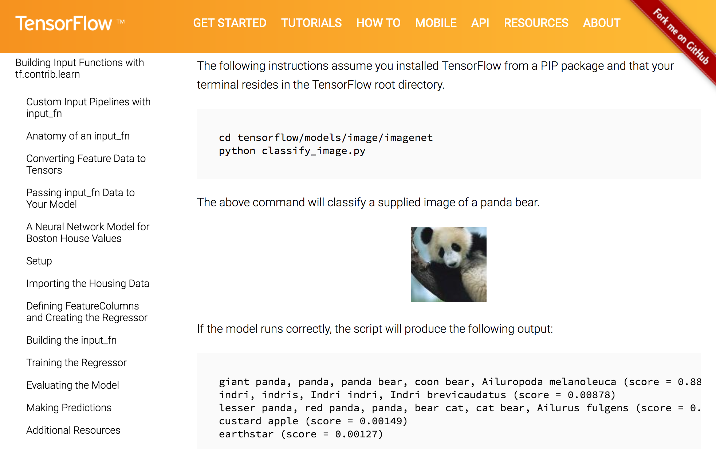
DNN image processing?

